Slide 1

Spring 2022
Introduction to Python, conda & jupyter
Programming and Data Analysis for Modern Neuroscience
NEU 365P/385L
Marcel Goldschen-ohm
Assistant Professor in the Department of Neuroscience, The University of Texas at Austin

Slide 2
Programming: Part of a modern scientist’s toolkit

Slide 3
Learning Objectives
You will understand compiled vs. interpreted code.
You will have a general understanding of the Python ecosystem.
You will be introduced to the Conda package manager.
You will be introduced to the JupyterLab environement.

Slide 4
First some basic software principles…

Slide 5
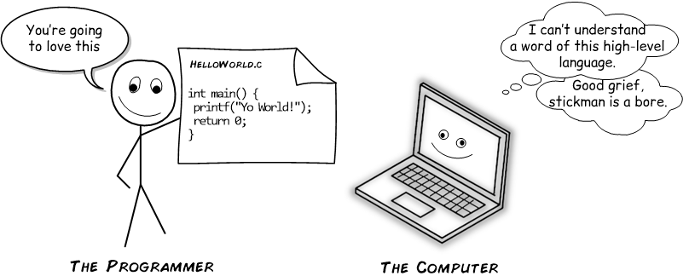
Computers don’t understand source code (i.e. the code that you write)

Slide 6
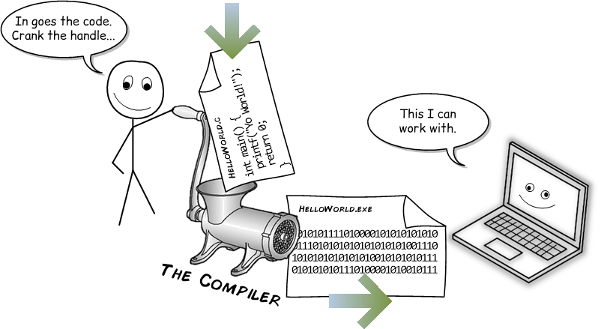
Option #1: Pre-compile source code → machine code

Slide 7


Option #1: Pre-compile source code → machine code
MACHINE CODE IS HARD TO WORK WITH
Humans can’t read it
Only compatible computers can run it
MACHINE CODE IS FAST
Optimized by compiler
Ready to Run

Slide 8
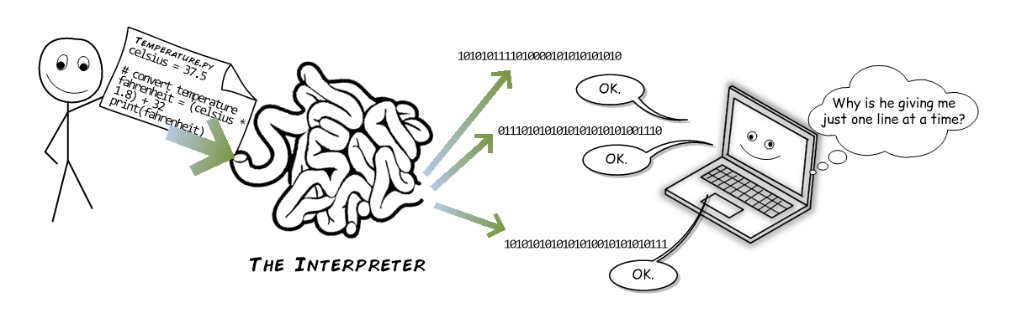
Option #2: Interpret the source code on the fly as you run the program

Slide 9
Option #2: Interpret the source code on the fly as you run the program
SOURCE CODE IS EASY TO WORK WITH
Human readable
Run anywhere
SOURCE CODE IS SLOWER
Not optimized
Need to interpret on the fly

Slide 10

Option #1.5: Compile the code just in time (JIT) prior to running
SOURCE CODE IS EASY TO WORK WITH
Human readable
Run anywhere
JIT COMPILED CODE IS FAIRLY FAST
Some optimization
Need to compile on the fly
JIT compile

Slide 11
Anyone can create a compiler and/or interpreter for any programming language.
IN PRINCIPLE | Any programming language can be compiled or interpreted or some mix of the two.
IN PRACTICE | Some languages are typically pre-compiled (e.g. C/C++) whereas others are typically interpreted (e.g. Python). Most modern data analysis languages tend to avoid end user management of pre-compiled machine code.

Slide 12
Python for data science is a mixture of interpreted and pre-compiled code
OTHER CODE
YOU CAN USE
YOUR
CODE

Slide 13
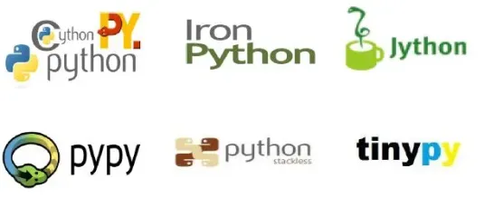
Which flavor of Python?
and more…

Slide 14
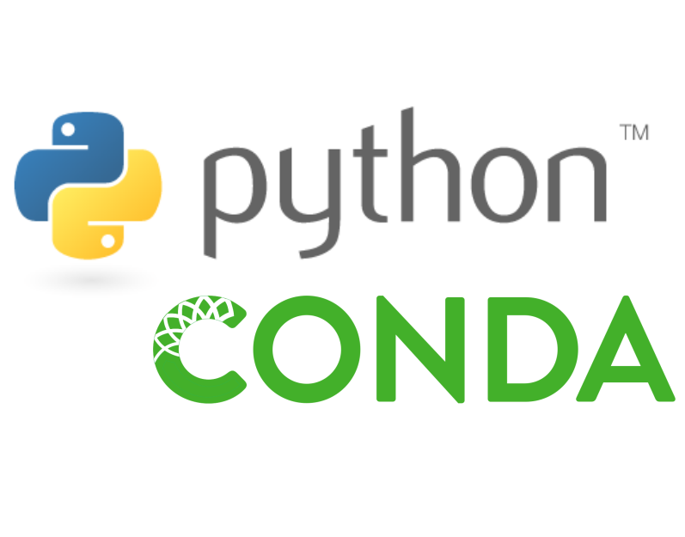
Which flavor of Python?
We’ll be using the standard version of Python distributed by Conda.
But you could use whatever you want.

Slide 15
Which version of Python?
Python 2
OLDER
Python 3
MODERN
Only use if necessary
Always use unless you have a good reason not to

Slide 16
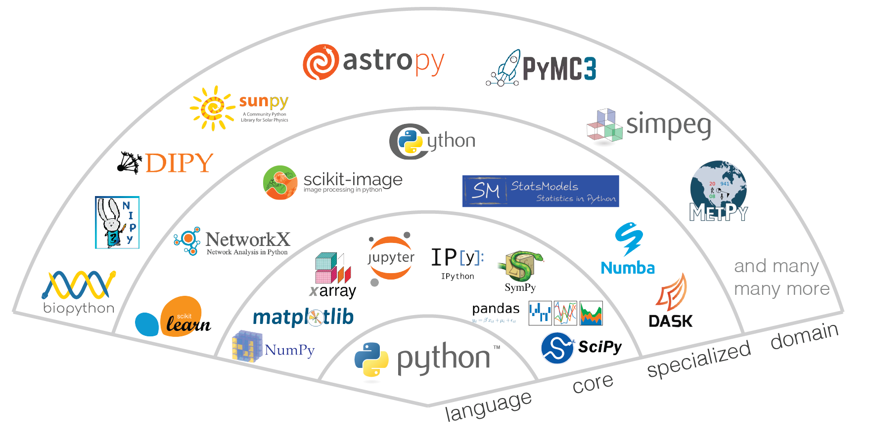
Python data science package ecosystem!
and many more…

Slide 17
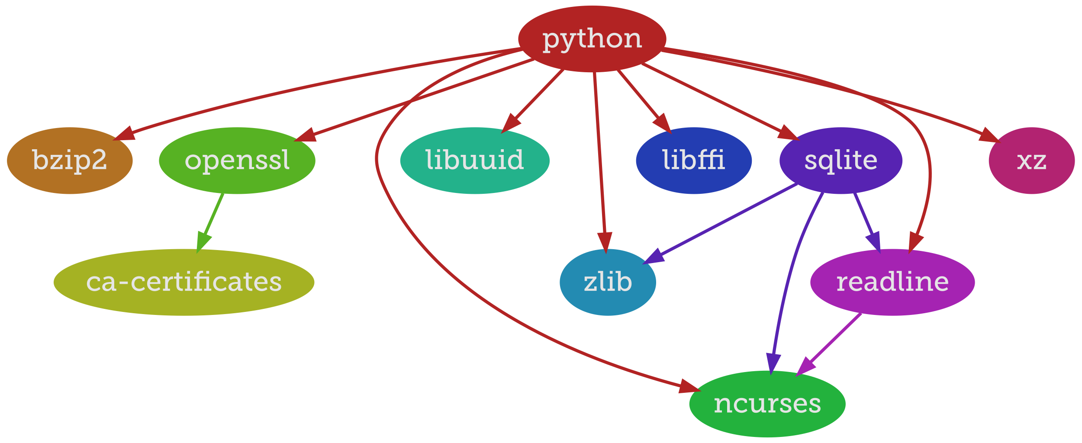
Managing packages is NOT for humans.

Slide 18
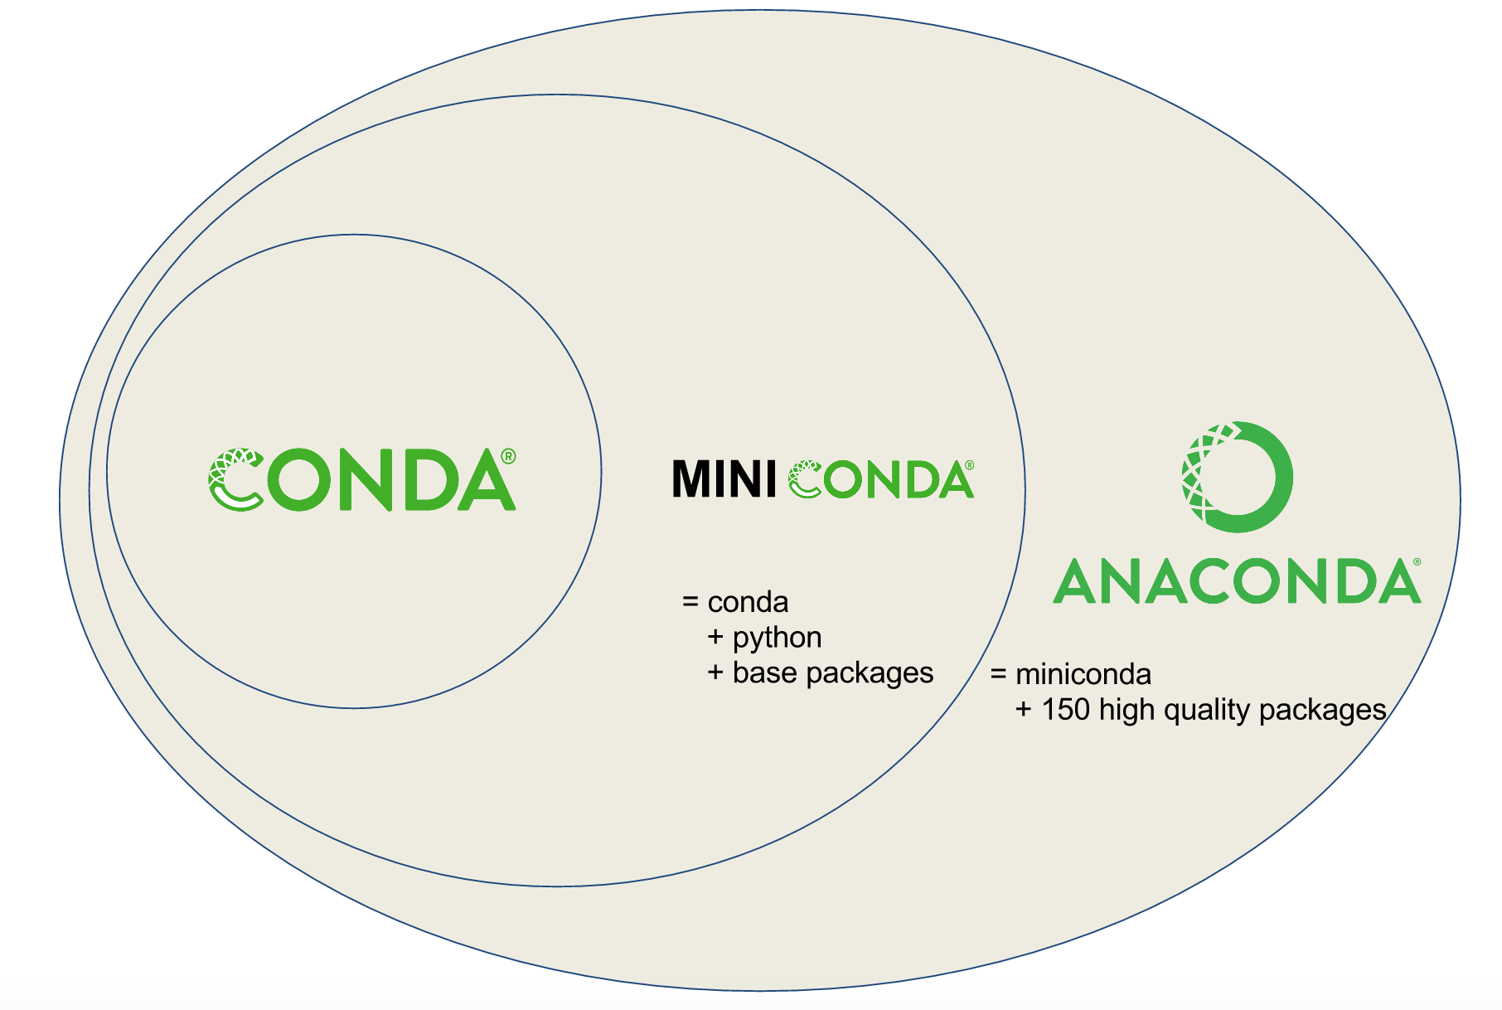
Conda package manager
Download and install Miniconda from https://docs.conda.io/en/latest/miniconda.html.
Choose the latest version of Python 3.

Slide 19

Conda package manager
conda --help
Get a list of conda commands.
conda install numpy
Install the numpy package.
conda install –c conda-forge jupyterlab
Install the jupyterlab package from the conda-forge channel.

Slide 20
Environments
Project A
Python 3
Numpy 1.2
Project B
Python 3
Numpy 1.1
Project C
Python 2
Statsmodels 0.1
Keep it simple - You can ignore environments for the most part in this course.
But keep them in mind for your actual projects later.

Slide 21
Why use Python for data science?
Pros
Large ecosystem of data science packages
Widely used and actively developed
Cons
Open source code not always well validated
Documentation often lacking
Easy to read source code
Run anywhere
Free open source code
Interpreted code is slow (but there are often solutions some of which we will discuss)

Slide 22

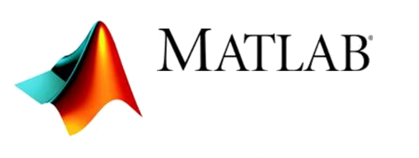
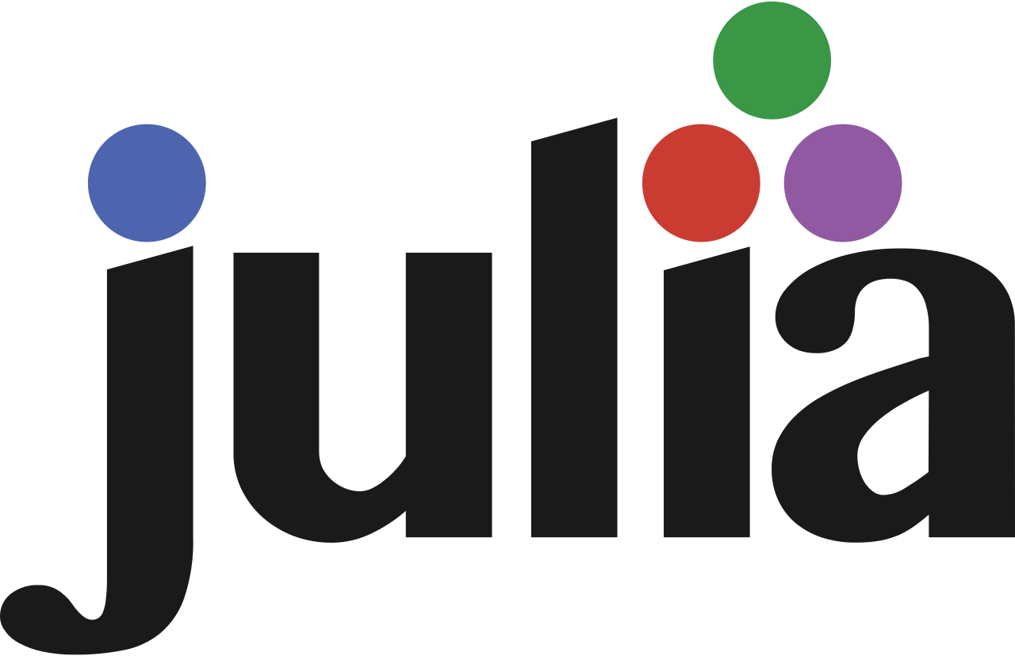
Some alternatives to Python

Slide 23
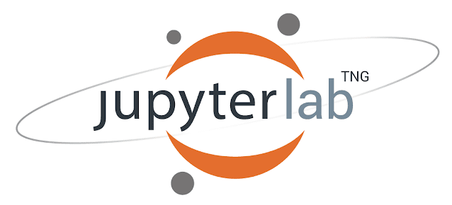
Jupyter Notebooks
A user interface for writing and running code.
conda install –c conda-forge jupyterlab
Install the jupyterlab package from the conda-forge channel.

Slide 24
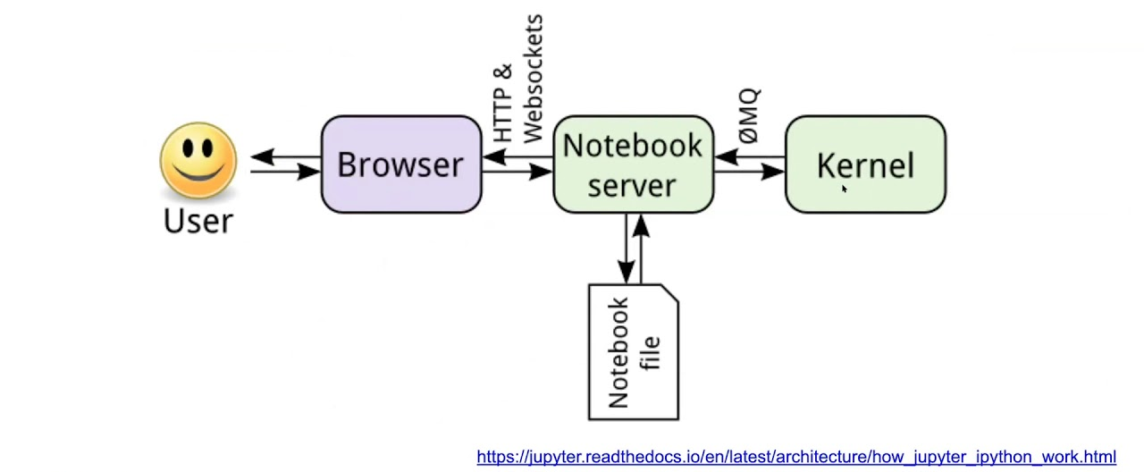
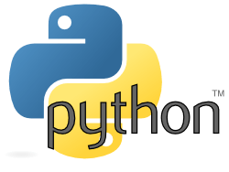
Jupyter Notebooks
Starts the server
You select a kernel (interpreter)
jupyter-lab
Opens a browser window
and more…

Slide 25

Alternative Python environments
There are quite a few other environments for writing and running Python code, and of course you could always write code in a simple text editor and run it from the command line.
For example, Spyder provides a MATLAB-like environment.

Slide 26
JupyterLab intro
For this course, we will primarily use JupyterLab.
Open jupyter-lab-intro.ipynb in JupyterLab

